Slide 1
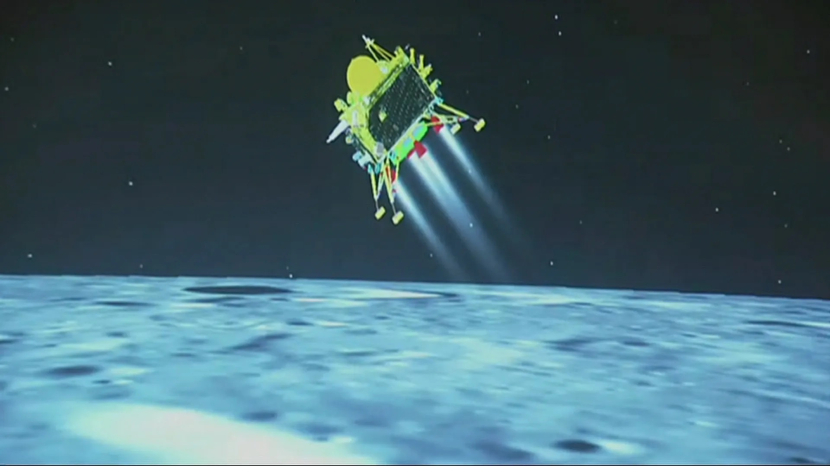




[{{{
Prediction & Classification
-a Data Insight Report
(Mini-Project 2)
Venu Gopal Madhav Annamdas, PhD

Slide 2

Contents
Prediction
Classification
Introduction
Assumption
Missing Data
Filling Data
Data Reduction
Cons. of Reg. Model
Regression /Prediction
Conclusions
Introduction
Assumption/Issues
Data Insights
Data Selection
Regressions/more models
Comparisons
Conclusions

Slide 3
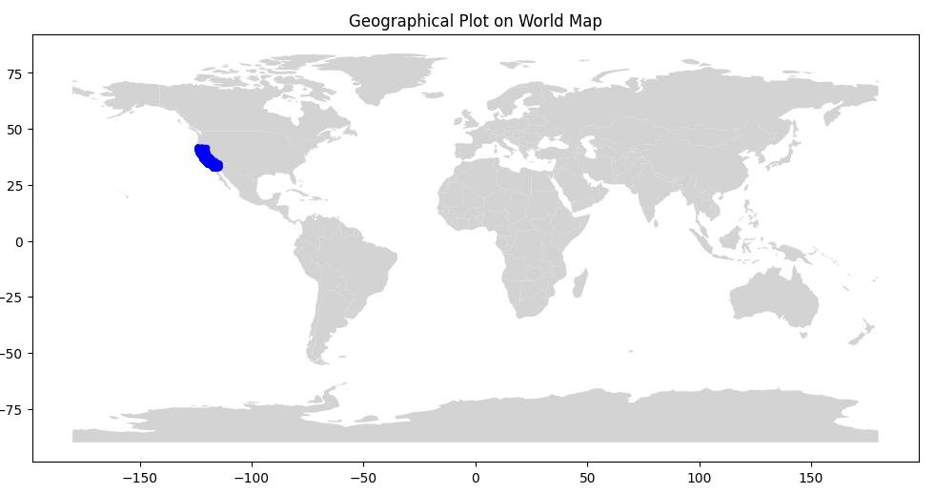
Introduction
Problem 1: To build a Regression Model to Predict the "median_house_value in California
Problem Statement: Exploring Available Data related to housing in California for (1) Insights, and (2) Predicting House Value.
Solution: Applying Machine Learning Algorithms such as Univariant, and Multi Variant linear Regression with Regularization.
Estimate (a) median_house_value using
(b) several independent variables, and finally,
(c) draw a ‘Value prediction/Regression line’

Slide 4
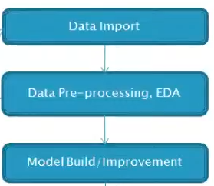
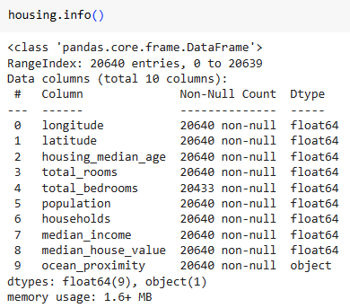
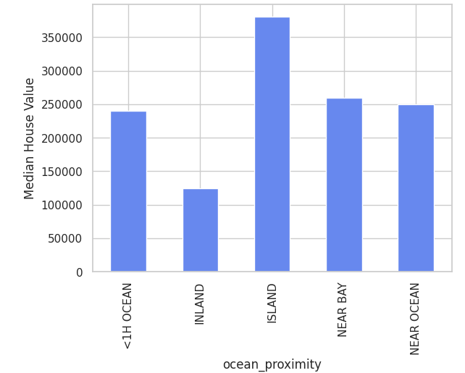
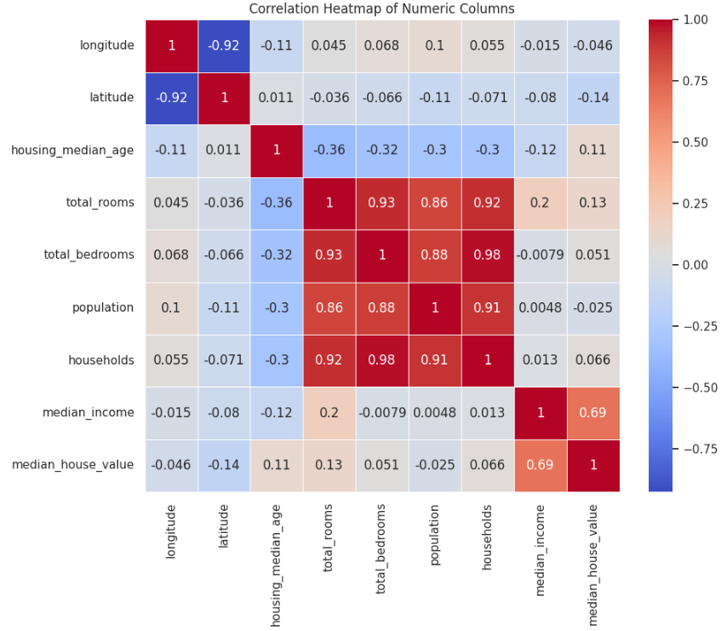
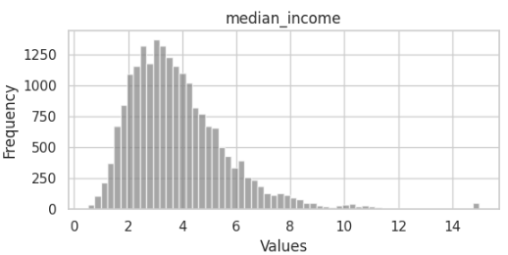
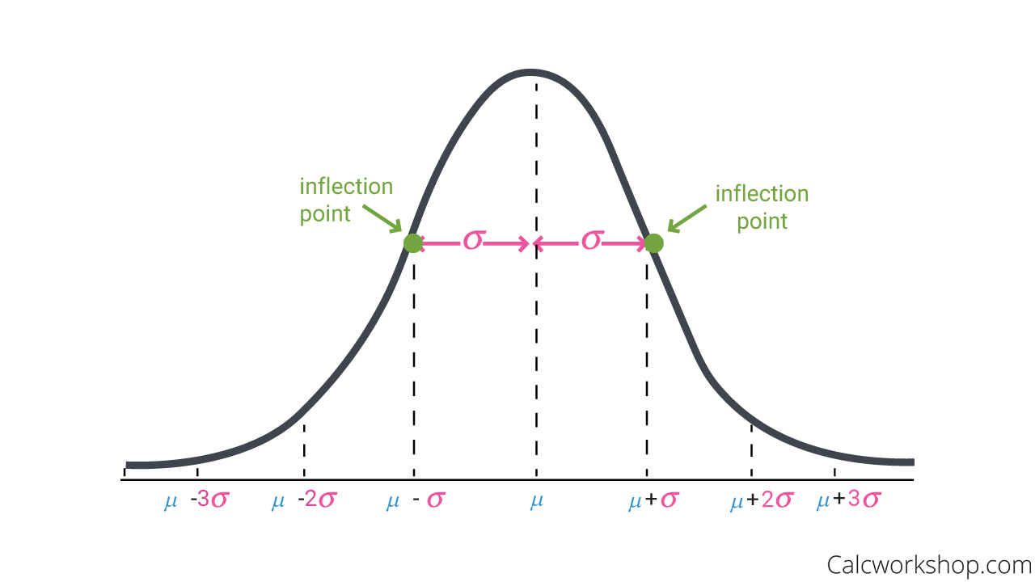
Process Flow → Housing Data Info → Assumptions
Target Variable i.e median_house_value
Assumption → Uniform
housing.drop(columns=['ocean_proximity'], inplace=True)
housing.shape
housing.head
housing.nunique()
Univariant Linear
Regression Model
Data - https://www.kaggle.com/datasets/camnugent/california-housing-prices **

Slide 5
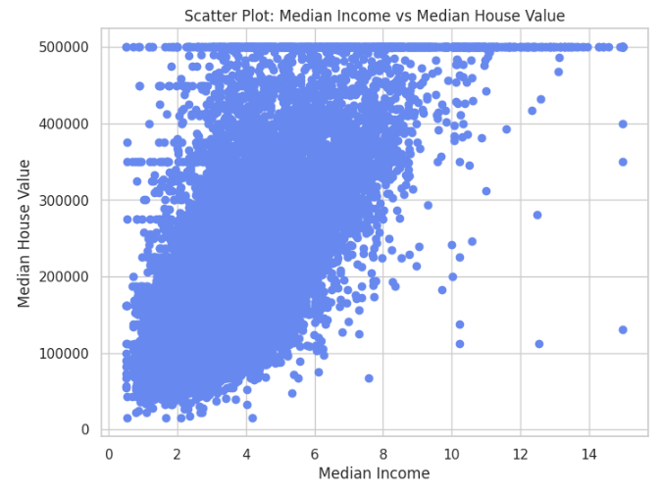
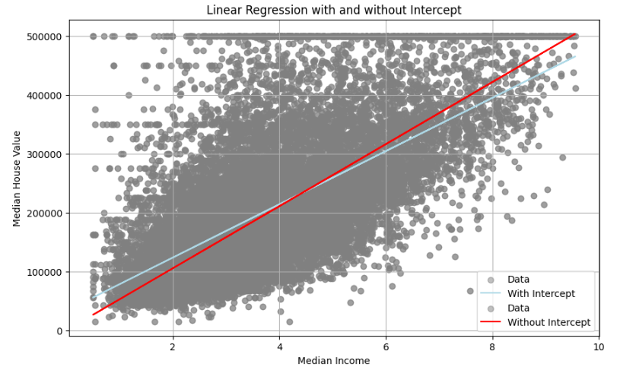
Process Flow → Assumptions
Univariant Linear Regression Model
Target Variable:- median_house_value
Predictor Variable:-median_income
Regression carried out for both with and without outliers based on Z- Score = 3
(R squared–not too much change)
R-squared : 0.868 (without intercept)
Insight: The richer you grow, your house value too grows

Slide 6
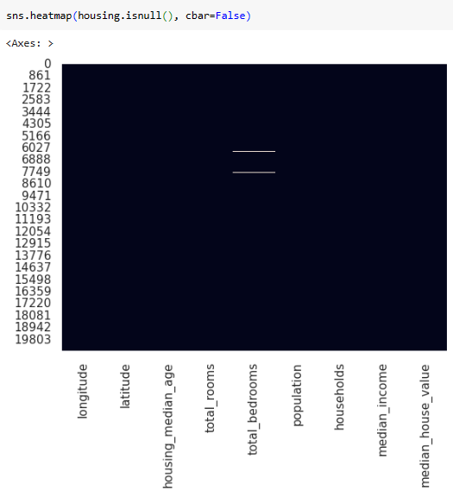
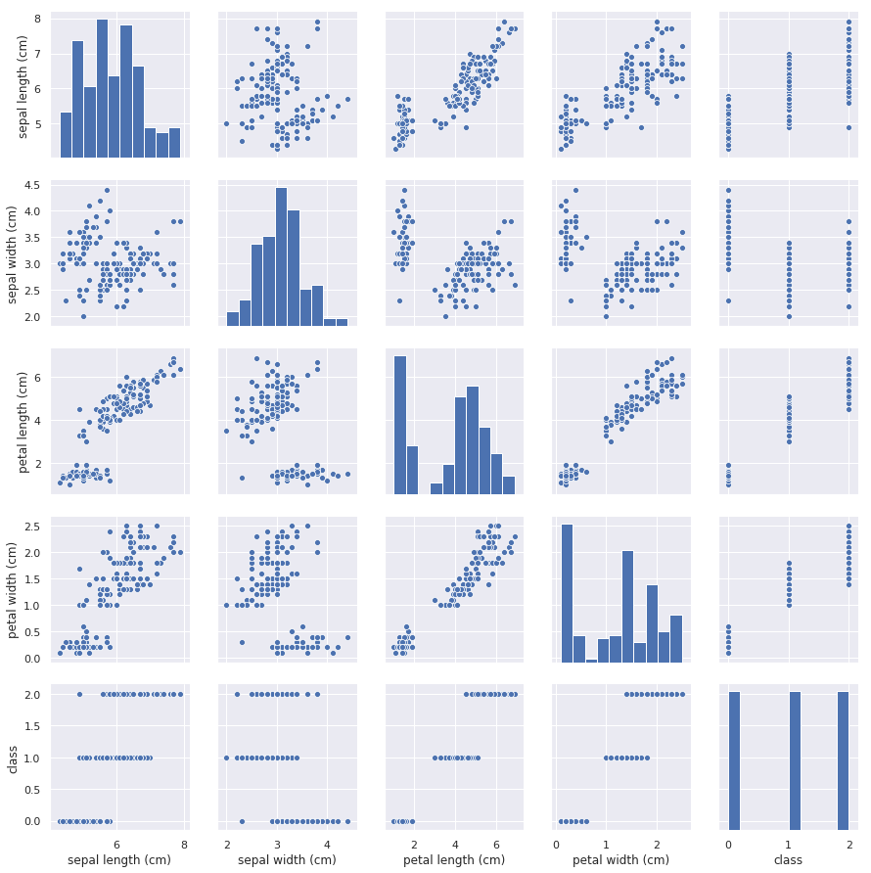
Process Flow → Missing Data
Multi-variant Linear Regression:
Predictor Variable: longitude, latitude, housing_median_age, total_rooms, total_bedrooms, population, households, median_income
Target Variable: median_house_value
Missing data in total_bedrooms
Pair plots
Insights: Which shows the relation between variables

Slide 7
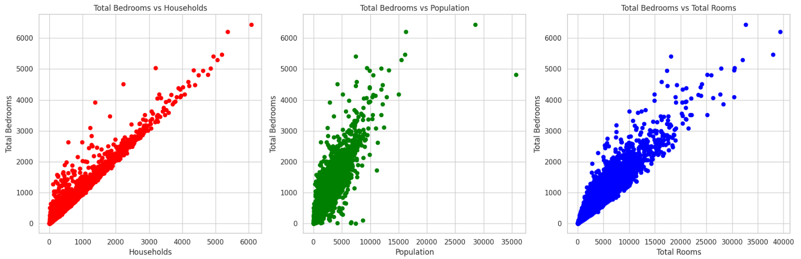

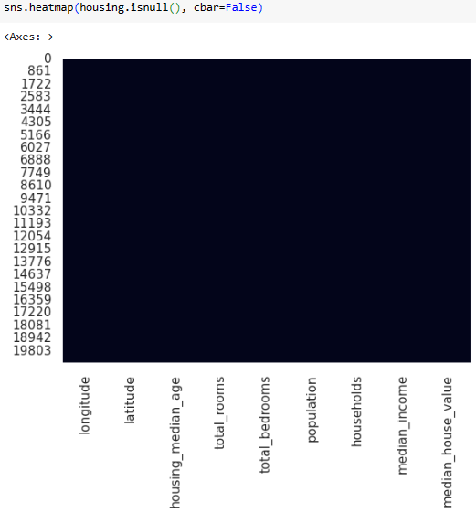
Process Flow → Filling Data
Filling
Missing data in Total_bedrooms
Filling up the missing values in 'total_bedrooms' based on households
Part of pair-plots

Slide 8
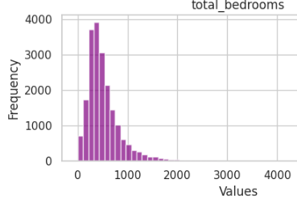
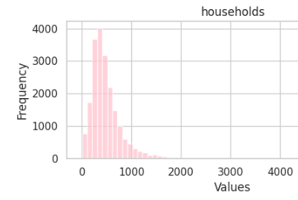
Process Flow → Data Reduction
Multi-variant Linear Regression:
Predictor Variable:longitude, latitude, housing_median_age, total_rooms, total_bedrooms, population, households, median_income
Target Variable: median_house_value
Collinearity observed : through distribution

Slide 9
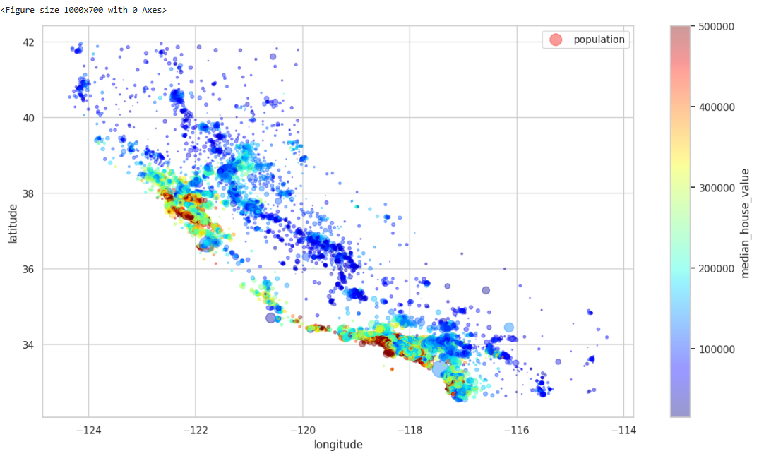
Process Flow → Construction of Regression Model
Multi-variant Linear Regression:
Predictor Variable:longitude, latitude, housing_median_age, total_rooms, total_bedrooms, population, households, median_income
Target Variable: median_house_value
Corr. Shows + & - values → + Directly increasing or - Directly decreasing
Let us look and one – Correlation example: Population vs med.hos.value
Insight: Rich - fewer population & vice-versa.

Slide 10
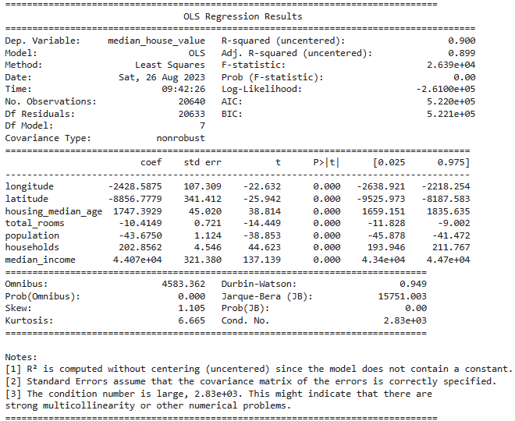
Process Flow → Regression Analysis
Multi-variant Linear Regression:
Predictor Variable:longitude, latitude, housing_median_age, total_rooms, total_bedrooms, population, households, median_income
Target Variable: median_house_value

Slide 11
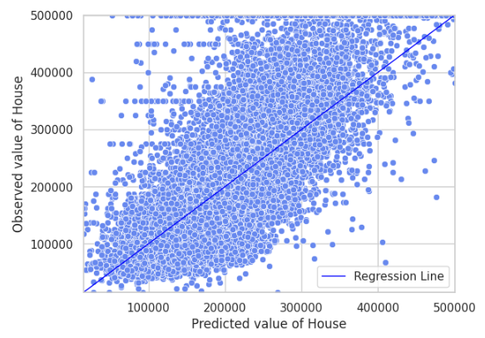
Process Flow → Housing Data Info → Prediction
Multi-variant Linear Regression:
Predictor Variable:longitude, latitude, housing_median_age, total_rooms, total_bedrooms, population, households, median_income
Target Variable: median_house_value
Extra info: 1. Categorized latitude-longitude. And did the regression again, no improvement
2. Regularization was also done, but it did not improve the result.

Slide 12

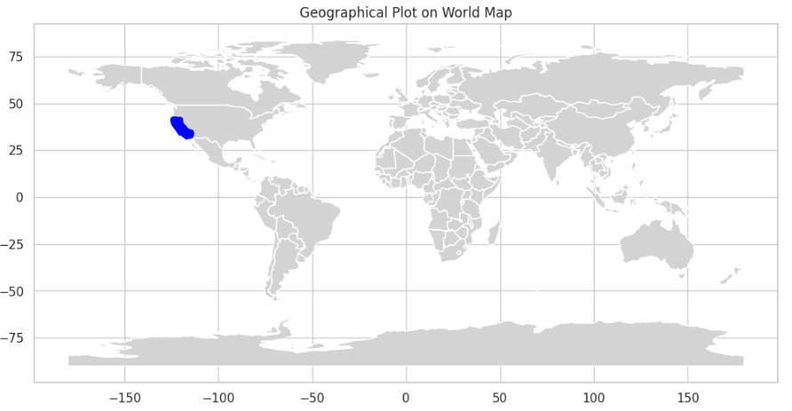
Prediction
Conclusions on :
to predict California housing value, Linear Regression modelling was carried out.
Studied the data and tried to get meaningful insights in a systematic way.
Interdependencies of columns were studied for missing data
First an univarient modelling was carried out. i.e from the Housing data. Median income was considered as the independent/predictor variable and median_house_value was considered as the target variable. Where the linear regression was carried out with and without intercept.
For the univariant Linear Regression Model, we can clearly see that the R-squared value is 0.86 and to save time, we can very well stop the modelling here.
But for the sake of completeness, Multi-variant Linear regression was carried out. The result of R square and other parameters improved a lot. The R-Square became 0.9.
For Regularization, we had to split the data into training and testing. Linear regression with and without regularization was carried out, but the results dropped. So the best result among the models is achieved by the multi-varient OLS Linear Regression Model.

Slide 13
Introduction
Problem 2: Build a classification model to predict stroke (= 1/0)
Problem Statement: Exploring Available Data related to stroke for classification as (a) stroke (=1) (b) no stroke (=0) (c) Data Insights, and (d)convergence
Solution: Application of six Machine Learning Algorithms/strategies such as (1) logistic regression
(2) logistic regression-Regularization.
(3) Support Vector Machine,
(4) SVM-Hyper tuned
(5) KNN
(6) KNN-with cross-validation.
Additionally, to handle unbalanced, employed class weights and Minority-Over Sampling was adopted. Finally, Target Variable i.e. stroke regression results are obtained

Slide 14
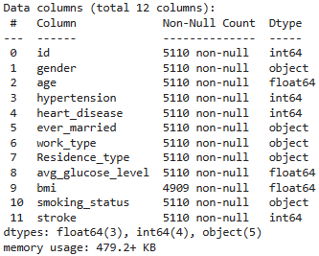
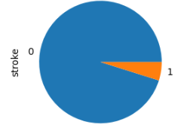
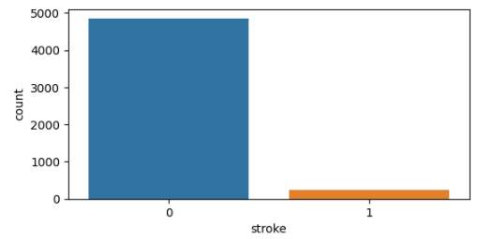
Process Flow → Stroke Data Info → Assumptions/Issues
Target Variable i.e stroke
Issue: class imbalance because class 0 has more data points or observations than class 1
Data - https://www.kaggle.com/datasets/fedesoriano/stroke-prediction-dataset

Slide 15
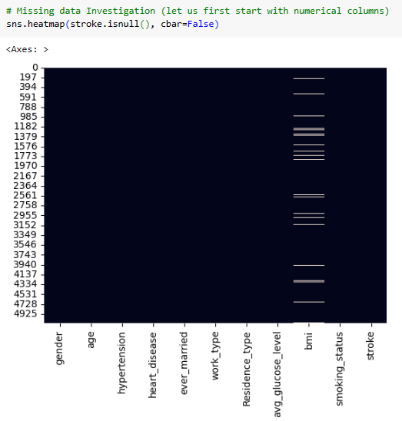
Process Flow → Stroke Data Info → Assumption(1)
Target Variable i.e stroke
No use in our model
Reduce
Find Missing
Fill missing
#it is just a unique id
stroke.drop("id",inplace=True,axis=1)
stroke.shape
stroke.head
Handling missing values :
bmi → height, weight.
→age for children and teens
( but not for adults)
Solution: Mean of age group was used to fill up
(source of observation: https://www.cdc.gov/healthyweight/assessing/bmi/adult_bmi/index.html )

Slide 16
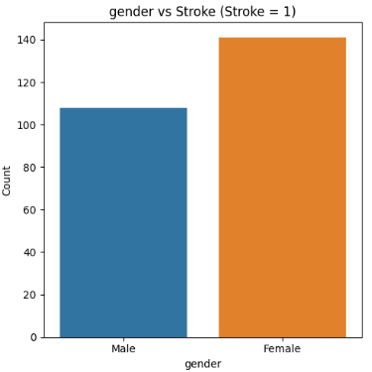
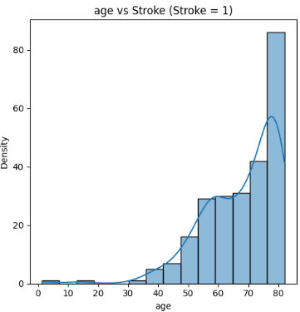
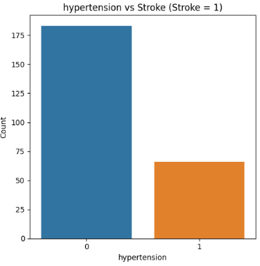
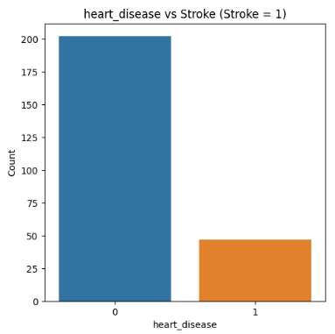
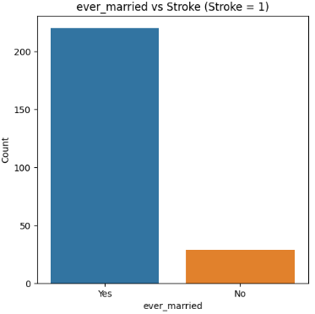
Process Flow → Data Insights
Stroke info (stroke=1)/ Insights
Pair plots
Insights:
Female > Male
Chances increase with age
30 % (approx.)of them already suffer from hypertension
25% (approx.)of them already suffer from heart disease
Married >>> unmarried
Insights: Which shows the relation between variables

Slide 17
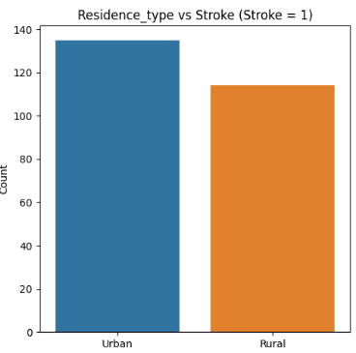
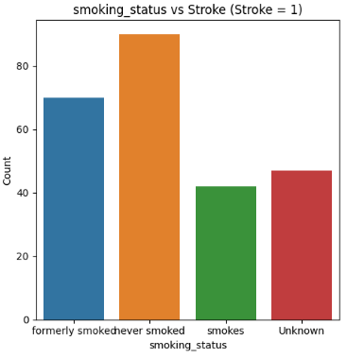
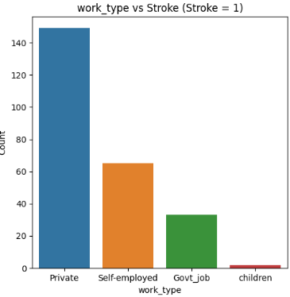
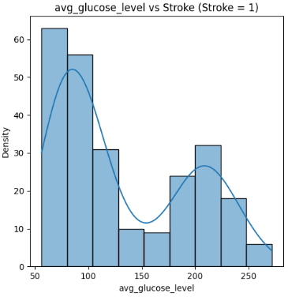
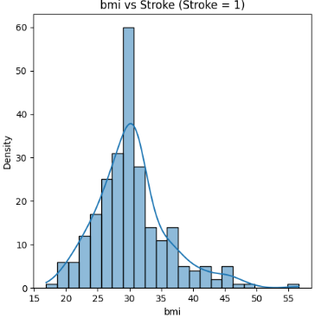
Process Flow → Data Insights
Stroke info (stroke=1)/ Insights
Pair plots
Insights:
Private > Self-emp > Govt. > Children
Urban> Rural
Lower glucose or higher glucose can have higher changes
Bmi at 30 as higher chances
Smoking/non smoking
Insights: Which shows the relation between variables

Slide 18
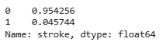
Process Flow → Stroke Data Info → Selection
Predictor Variables:
Target Variable:
Initial Stroke Data
Train-Test Split
Feature Scaling
Check for distribution of labels

Slide 19

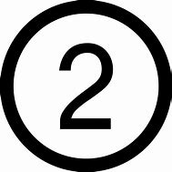
Process Flow → Stroke Data Info →Regression
1. Logistic Regression Model
Assumption/ correction: Apply Class Weight based on the inverse of the class amount
model = LogisticRegression(class_weight={0:0.045,1:0.95})
2. Logistic Regression Model - Regularization
Assumption/ correction: Apply Class Weight based on the inverse of the class amount
Ridge-hyper parameter tuning
"class_weight": [{0: w, 1: 1.0 - w} for w in weights]
Accuracy: 0.7446183953033269
Precision: 0.16040955631399317
Recall: 0.7580645161290323
F1-score: 0.26478873239436623
ROC-AUC: 0.8541666666666666
Intercept: -1.0485401664326774
Coefficients: [1.54185705 0.1391394 0.08752663 0.19371839 0.02212134]
Accuracy: 0.860078277886497
Precision: 0.22448979591836735
Recall: 0.532258064516129
F1-score: 0.3157894736842105
ROC-AUC: 0.852486559139785
Intercept: -1.0485401664326774 Coefficients: [1.54185705 0.1391394 0.08752663 0.19371839 0.02212134]
Confusion Matrix:
| Predicted Positive | Predicted Negative
--|--------------------|--------------------
Actual Positive | 47 | 15
Actual Negative | 246 | 714
Actual Positive | 33 | 29
Actual Negative | 114 | 846

Slide 20
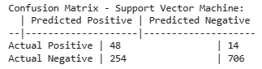
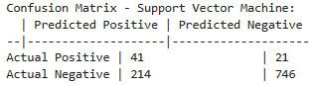
Process Flow → Stroke Data Info → Regression
3. Support Vector Machine
Assumption/ correction: Apply Class Weight based on the inverse of the class amount
class_weights = {0: 0.045, 1: 0.95}
Linear Kernel
4. Support Vector Machine (cross-validation & hyper par.tuning)
Assumption/ correction: Apply Class Weight based on the inverse of the class amount
class_weights = {0: 0.045, 1: 0.95}
Linear Kernel
Accuracy: 0.7377690802348337
Precision: 0.15894039735099338
Recall : 0.7741935483870968
F1-score : 0.26373626373626374
Best Parameters:
{'C': 1, 'gamma': 0.001, 'kernel': 'rbf’}
Accuracy : 0.7700587084148728
Precision: 0.1607843137254902
Recall: 0.6612903225806451
F1-score : 0.2586750788643533
Remark: Similar to Logistic Regression
Remark: Similar to Logistic Regression

Slide 21
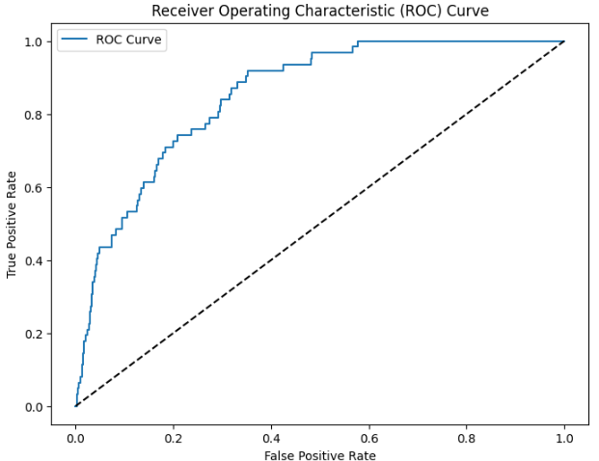
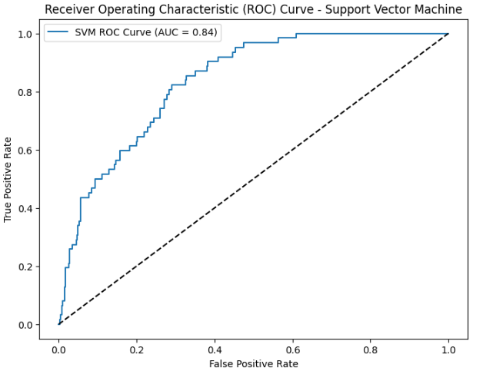
Process Flow →Comparisons
(1) Logistic Regression/
(2) Logistic Regression -Regularization
Vs.
(3) Support Vector Machine Model
(4) Support Vector Machine (cross-validation & hyper Par. tuning)
AUC=0.85
AUC=0.84

Slide 22
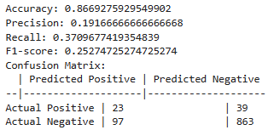
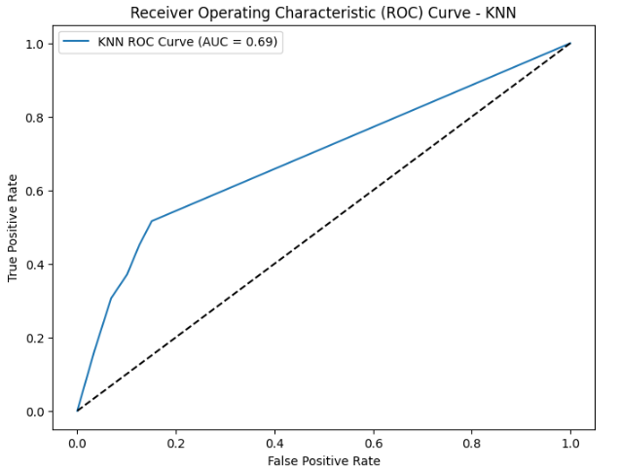
Process Flow →More models
5. Gaussian Naive Bayes : No class-weight compensation so it was not considered
6. KNN classification method : No class-weight compensation but we can use RandomOverSampler :
Oversampling involves creating more instances of the minority class to balance it with the majority class.
The RandomOverSampler does this by randomly selecting samples from the minority class with replacement until the class distribution is more balanced.

Slide 23
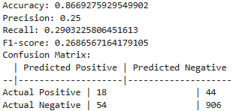
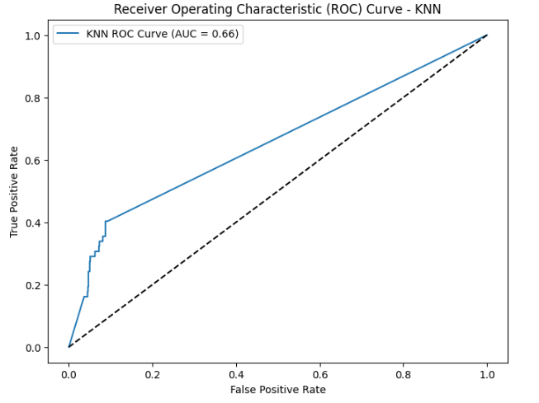
Process Flow →More models
7 KNN classification method with hyper parameter tuning : No class-weight compensation but we can use RandomOverSampler :
Best Parameters:
{'n_neighbors': 3, 'p’: 1 (Manhattan distance), 'weights': 'distance'}

Slide 24
Conclusions on:
Classification
We began our learning journey by understanding the STROKE through various dimensions, such as stroke occurance among male and female, locations such as urban and rural etc. we found that, the chances of stroke occurance are as follows
1. Female > Male
2. Chances increase with age
3. 30 % (approx.)of them already suffer from hypertension
4. 25% (approx.)of them already suffer from heart disease
5. Married >>> unmarried
6. Private > Self-emp > Govt. > Children
7. Urban> Rural
8. Lower glucose or higher glucose can have higher changes
9. Bmi at 30 as higher chances
10. Smoking/non smoking
11. More than 6 Regression models were carriedout but the best results are obtained for Logistic Regression-Regularization.
Best: Logistic Regression-Regularization
Accuracy: 0.860078277886497
Precision: 0.22448979591836735
Recall: 0.532258064516129
F1-score: 0.3157894736842105
ROC-AUC: 0.852486559139785

Slide 25




